Slide 1
PARTIAL DIFFERENTIAL EQUATIONS
(Solution and Types)
Dr. Anirban Tarafdar
Amrita Vishwa Vidyapeetham, Faridabad

Slide 2
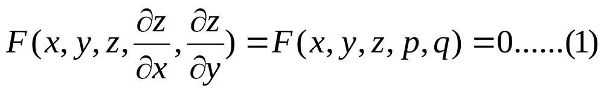
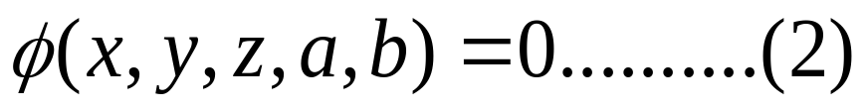
Different Integrals of Partial Differential Equation
1. Complete Integral (solution)
Let
be the Partial Differential Equation.
The complete integral of equation (1) is given
by

Slide 3
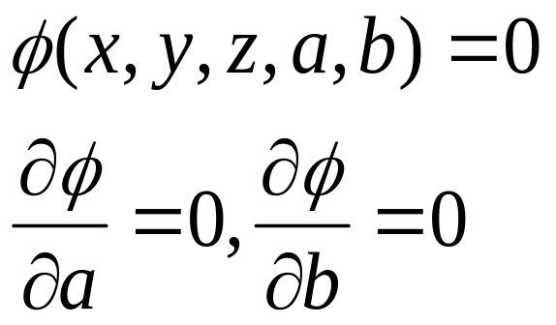
2. Particular solution
A solution obtained by giving particular values to
the arbitrary constants in a complete integral is
called particular solution .
3.Singular solution
The eliminant of a , b between
when it exists , is called singular solution

Slide 4
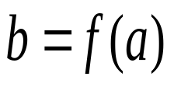
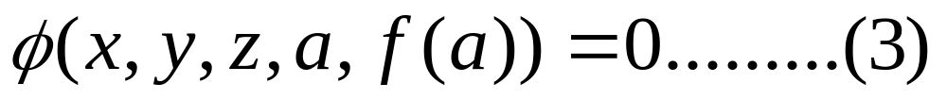
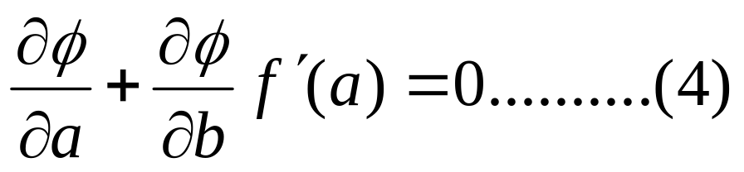
4. General solution
In equation (2) assume an arbitrary relation
of the form . Then (2) becomes
Differentiating (2) with respect to a,
The eliminant of (3) and (4) if exists,
is called general solution

Slide 5
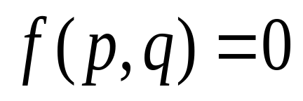
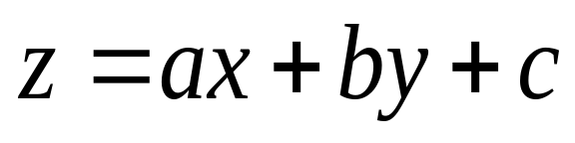
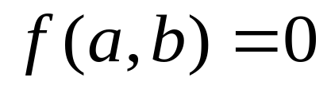
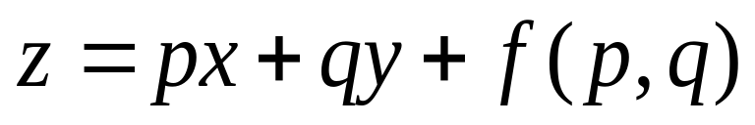
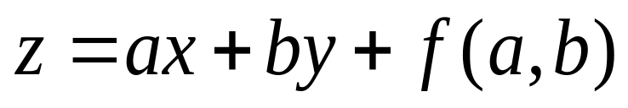
Standard types of first order equations
TYPE-I
The Partial Differential equation of the form
has solution
with
TYPE-II
The Partial Differential Equation of the form
is called Clairaut’s form
of pde , it’s solution is given by

Slide 6
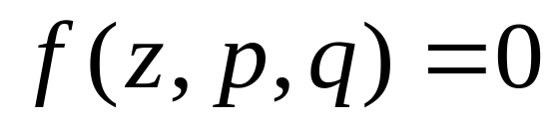
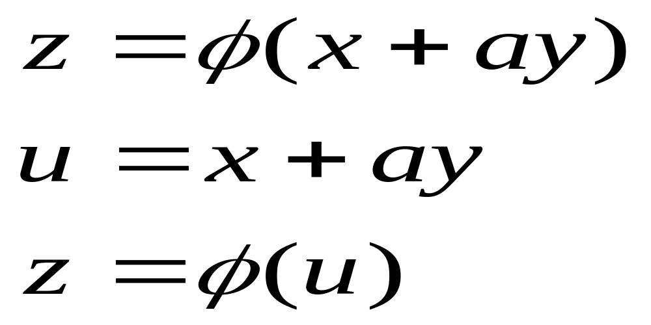
TYPE-III
If the pde is given by
then assume that

Slide 7
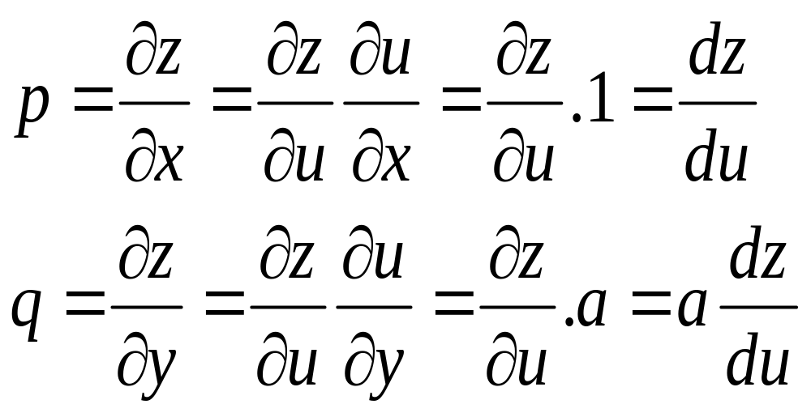

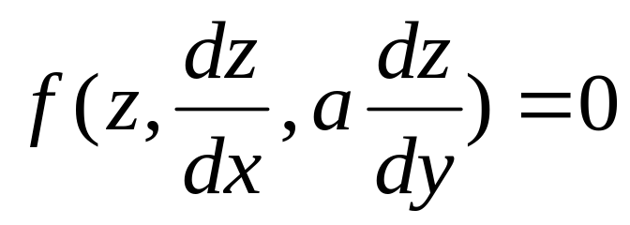
The given pde can be written as
.And also this can
be integrated to get solution

Slide 8
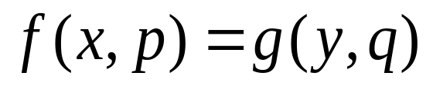
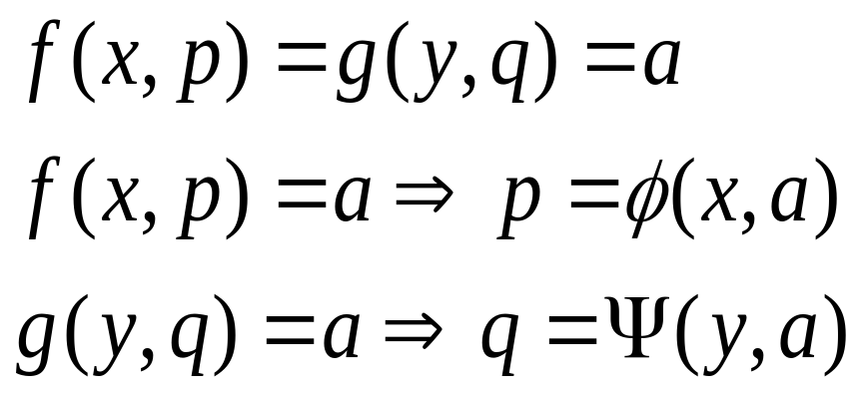
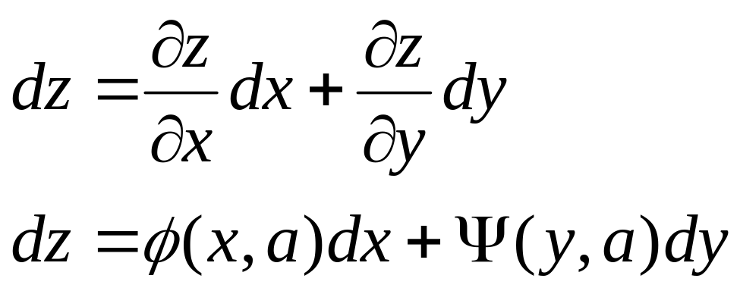
TYPE-IV
The pde of the form can be solved by assuming
Integrate the above equation to get solution

Slide 9
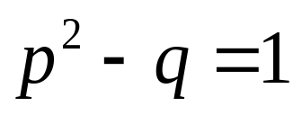

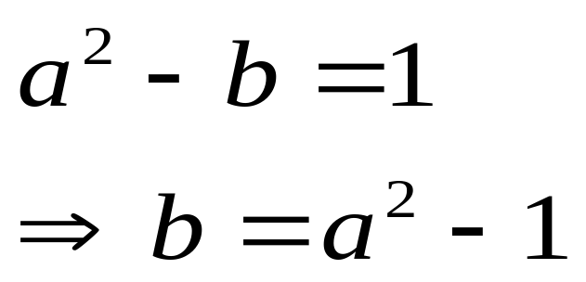
SOLVED PROBLEMS
1.Solve the pde and find the complete
and singular solutions
Solution
Complete solution is given by
with

Slide 10
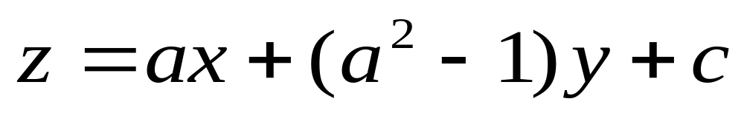
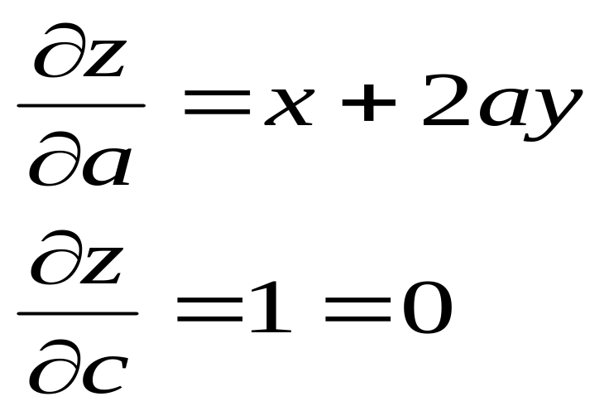
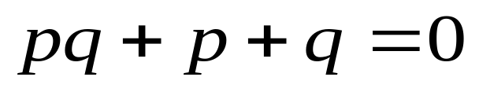
d.w.r.to. a and c then
Which is not possible
Hence there is no singular solution
2.Solve the pde and find the complete, general and singular solutions

Slide 11
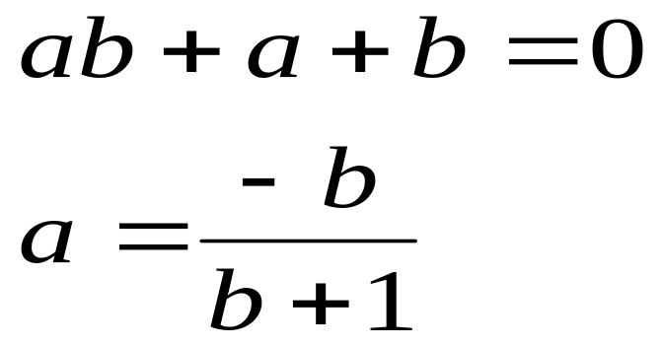
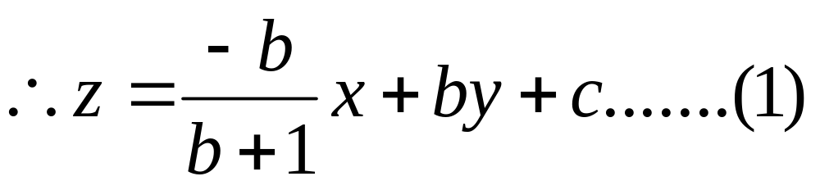
Solution
The complete solution is given by
with

Slide 12
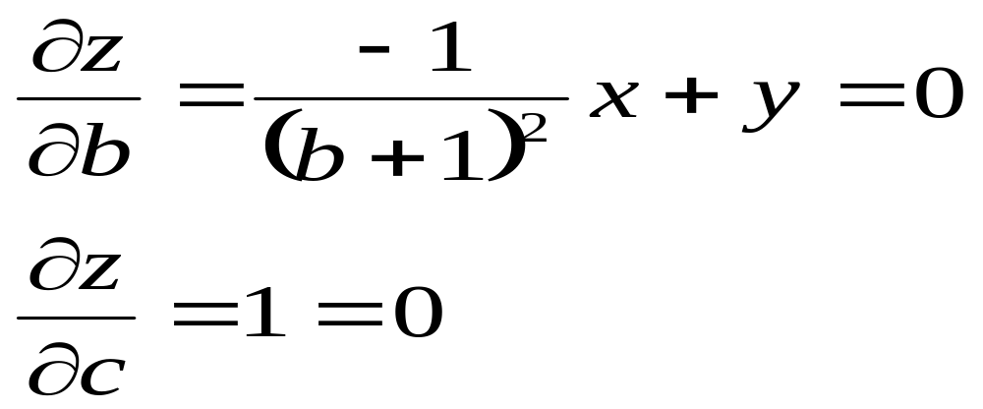
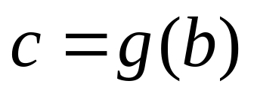
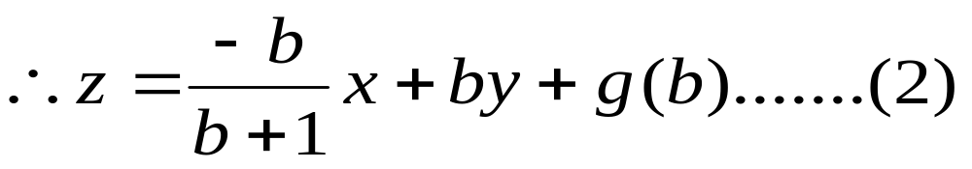
no singular solution
To get general solution assume that
From eq (1)

Slide 13
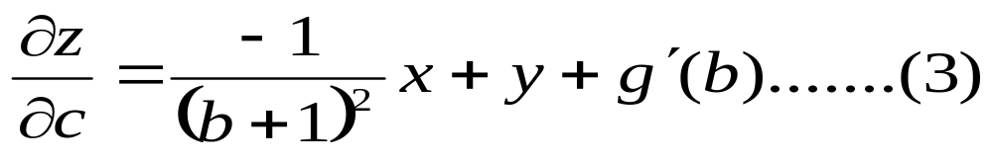
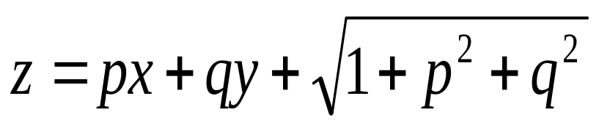

Eliminate from (2) and (3) to get general solution
3.Solve the pde
and find the complete and singular solutions
Solution
The pde
is in Clairaut’s form

Slide 14
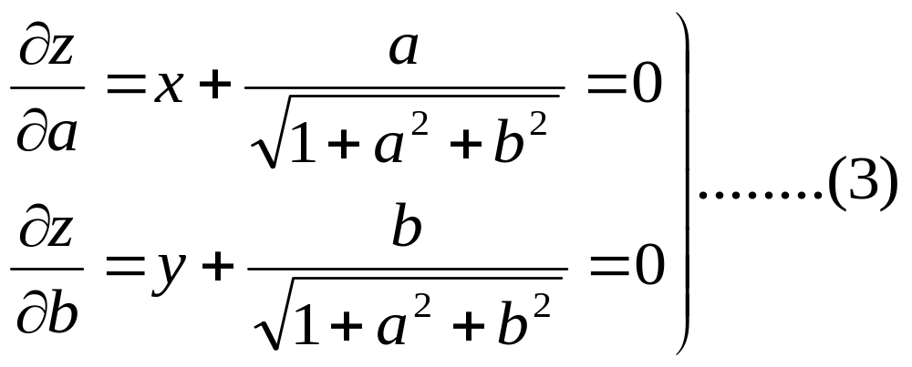
complete solution of (1) is
d.w.r.to “a” and “b”

Slide 15
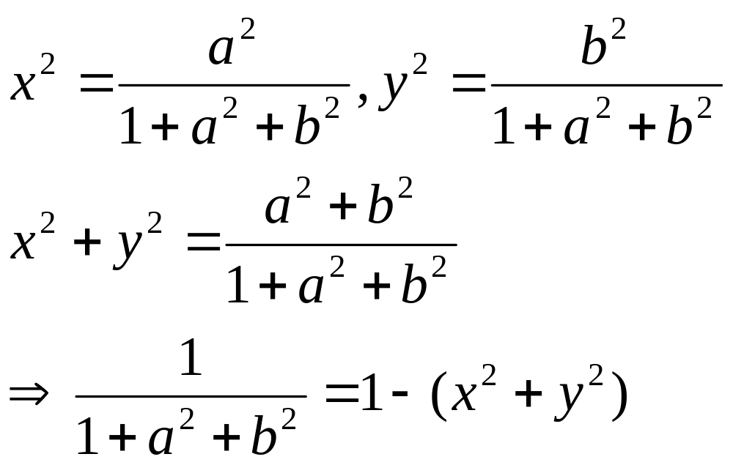
From (3)

Slide 16
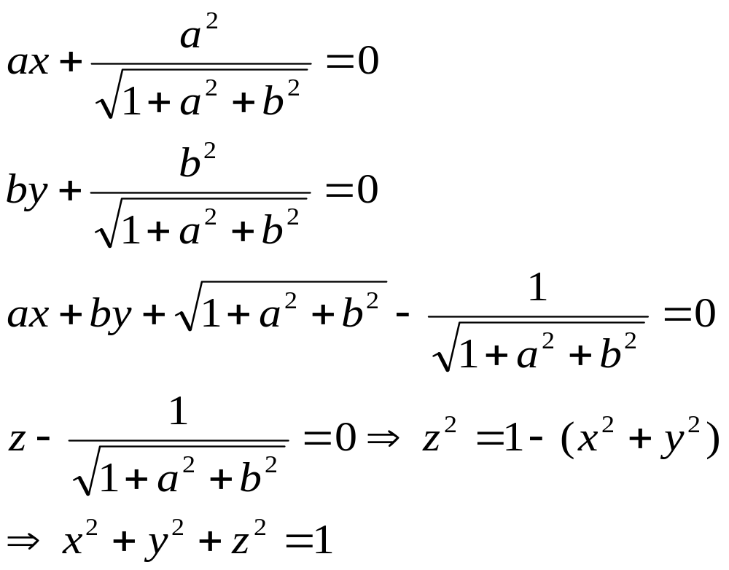
is required singular solution

Slide 17
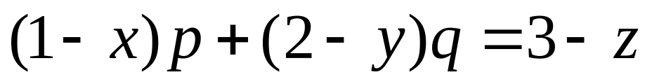
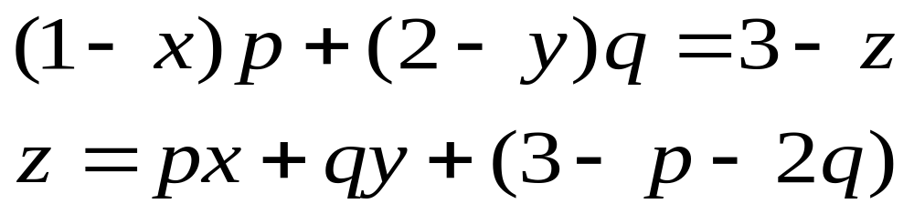
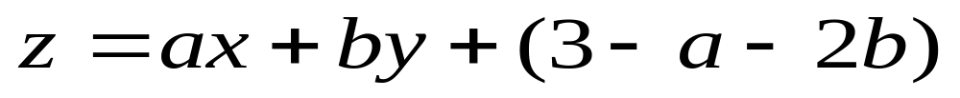
4.Solve the pde
Solution
pde
Complete solution of above pde is

